Slide 1
Fair & Prudent Valuation: a High-Level Overview
Date: May 2026
Presentation to HSBC Risk Academy
Prepared by: Laurent-Olivier Valigny, Global Head Valuation Risk, Product Control
(Including edits by Artur Zajac, Head of Kraków Product Control Quants)

Slide 2
Disclaimer
This presentation has been prepared by HSBC Service Delivery (Polska) Sp. z o.o. with a registered office located at Kapelanka 42A, ​
30-347 Kraków, Poland, registered in the District Court for Kraków-Śródmieście in Kraków, XI Commercial Division of the National Court Register, under the number KRS 0000310459, share capital (entirely paid) in the amount of 67 689 500,00 PLN, NIP 525-242-91-07, hereinafter referred to as “HSBC”. ​
​
HSBC has based this document on information obtained from sources it believes to be reliable but which has not been independently ​
verified. While this information has been prepared in good faith, no representation or warranty, express or implied, is or will be made ​
and no responsibility or liability is or will be accepted by the HSBC, or by any of their respective officers, employees or agents in relation​
to the accuracy or completeness of the Documents or any other written or oral information made available to any interested party or its advisers and any such liability is expressly disclaimed. Any charts and graphs included are from publicly available sources or proprietary ​
data. No liability is accepted whatsoever for any direct, indirect or consequential loss arising from the use of this document. HSBC is under ​
no obligation to keep current the information in this document. You are solely responsible for making your own independent appraisal of ​
and investigations into the data, products, financial instruments and transactions referred to in this document and you should not rely on ​
any information in this document as constituting investment advice. Neither HSBC nor any of its affiliates are responsible for providing you with legal, tax or other specialist advice and you should make your own arrangements in respect of this accordingly. The issuance of and details contained in this document, which is not for public circulation, does not constitute an offer or solicitation for, or advice that you ​
should enter into, the purchase or sale of any security, commodity or other financial instrument or master agreement, or any other contract, agreement or structure whatsoever. This document is intended to be distributed in its entirety. Reproduction of this document, in whole or in part, or disclosure of any of its contents, without prior consent of HSBC or any associate, is prohibited.​
2

Slide 3
Contents
Trading Book
Valuations
PVA Scope & Regulatory framework
Components (AVAs)
Acronyms:
PVA: prudent value (/valuation)
AVA: additional valuation adjustments
3

Slide 4
Trading Book
A financial asset is any asset that is cash, the right to receive cash or another financial asset or a commodity, or an equity instrument. A financial liability is the contractual obligation to deliver cash or another financial asset or a commodity.
Banks must fair value daily any trading book instrument and recognize any valuation change in the profit and loss (P&L) account.
Any instrument a bank holds for one or more of the following purposes must, when it is first recognized on its books, be designated as a trading book instrument,
short-term resale;
profiting from short-term price movements;
locking in arbitrage profits; or
hedging risks that arise from instruments meeting the above
4

Slide 5
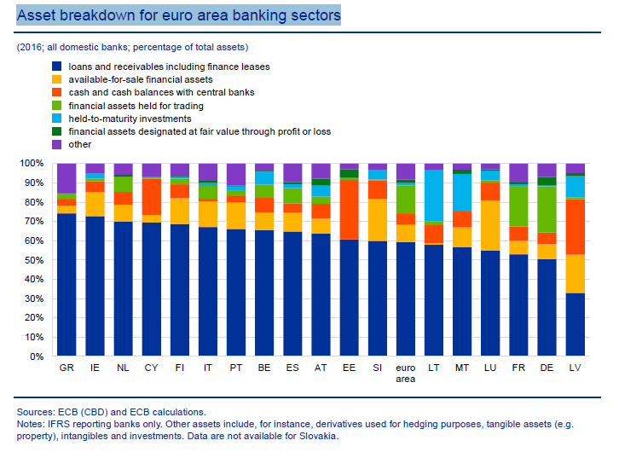
Trading Book
5
5

Slide 6
Valuation: one asset, multiple prices
Transaction Pricing
  direct /inderect cost of manufacturing
  required margin
  bidding / negotiantion / exploiting opportunities
Accounting Books & Records (P&L)
  in line with accounting standards
  for trading book: Fair Value
Regulatory valuation (Capital)
  conservative pricing in normal market conditions
  assuming some level of confidence
Fire sale, Data room, Recovery&Resolution
  forced sale under normal market conditions
[Stress Testing (Capital) – not a going-concern price]
  normal operations under hypotetical stressed market conditions
6

Slide 7
Accounting Value : Best estimate valuation, on a going-concern basis
“Fair value is the amount for which an asset could be sold or a liability transferred, between knowledgeable, willing parties in an arm’s length transaction”
“Fair value is the price that would be received to sell and asset or paid to transfer a liability in an orderly transaction between market participants at the measurement date”
  “Because different entities with different activities may have access to different markets, the principal (or most advantageous) market for the same asset or liability might be different for different entities. It is possible that entities will arrive at different estimates of Fair value of the same instrument at the same measurement date, and the valuation techniques and inputs used by both entities can still meet the objectives of fair value measurement…”(PWC)
  The fair value of a liability reflects nonperformance risk, the risk that an entity will not fulfil an obligation, including the entity’s own credit risk.
  “ one of the more ridiculous concepts that's ever been invented in accounting“(James Dimon)
  Blockage discounts are typically viewed as an adjustment to the quoted price of an asset or a liability because the market’s normal daily trading volume is insufficient to absorb the quantity (the size of the block) held by the entity. blockage factors are strictly prohibited.
As an accounting measure, Fair value is supposed to reflect an expected value of positions (in statistical sense).
7

Slide 8
Fair Value Adjustments (FVAs)
Typical Fair Value Adjustments being considered:
Indepemndent Pricing adjustment – refelcting alternative choices of price sourcing
Model Risk FVA – correcting modelling biases
Bid-Offer reserve – bringing mid price value to exit price value
Market Price Uncertainty – assessment of exit cost when exit prices are not directly observable
Credit Valuation Adjustment (CVA) - reflecting counterparty credit risk
Debit Valuation Adjustment (DVA), Own Credit Spread Adjustment (OCS) – reflecting own credit risk
Funding Valuation Adjustment (FVA aka FuVA aka FFVA...) – reflecting cost of funding collateral (variation margin) to cover future outstanding exposures
Margin Valuation Adjusmtent (MVA) – covering costs of funding Initial Margin
Early Termination, Administration Costs, Operational Risk...
Capital Valuation Adjustment (KVA) – cost of raising necessary capital (disputable)
[Day-one adjustment – reflecting pricing difference vs transaction price at inception. “Inverse FVA”]
8
8

Slide 9
FVA examples
Independent Price Verification
Compares the book value of a trade with market consensus
Market consensus is typically derived through re-pricing the trade using alternative market data sources and averaging the results
In absence of alternative market data providers a Market Data Uncertainty adjustment may be considered to reflect uncertainty around the unobservable price
Bid-Offer reserve
Lowers the value of the portfolio by half of Bid-Ask (Bid-Offer) spread
Can be computed on trade-level or portfolio level
Trade level computation:
                Bid-Offer reserve = (Exit price – Mid price) * notional
            Portfolio-level (risk-based) computation:
            Bid-Offer reserve is a sum over all risks of the portfolio (Delta, Vega, etc.) * exit-mid cost of hedge
            Heavily depending on risk-netting assumptions
            CVA – will be covered on next lecture
9
8

Slide 10
Valuation: How fair is Fair Value?
« The approach to the valuation of monoline CVA positions, which became appartent in FSA analysis in early 2009, and which showed Barclays choosing valuations clearly at the agressive end of the acceptable spectrum » (PRA)
“At the height of the financial crisis, Deutsche Bank’s financial statements did not reflect the significant risk in these large, complex illiquid positions,”. “Deutsche Bank failed to make reasonable judgments when valuing its positions and lacked robust internal controls over financial reporting.” (SEC)
“JPMorgan did not timely detect or effectively challenge questionable valuations by the SCP traders as the portfolio’s losses accumulated in the first quarter of 2012 and publicly misstated its financial results for that period.” (SEC)
“Traders shocked by $712m CVA loss at StanChart Bank’s new methodology has been used by some rivals for more than a decade” (Risk.net)
“Feds Say PIMCO Used Performance-Enhancing Odd Lots To Increase Size Of Bond ETF. SEC says that BOND’s impressive premiere was buoyed by a strategy of buying up cheap odd lots – irregularly sized bundles of bonds that portfolio managers trade at a discount – and at the end of the day valuing them as if they were ordinary, full-priced round lots.” (Dealbreaker)
In December 2018, Natixis blamed a “deficient” hedging strategy related to “some specific products traded with clients in Asia” for the loss. This is said to be a reference to autocallable notes sold in South Korea. It resulted in the French bank registering a €220 million loss at its equity trading unit for the fourth quarter. (Risk.net)
10
8

Slide 11
Regulatory Prudent Value: post 2008 crisis framework
Prudent Valuation is part of the Revision to the Basel II Market Risk Framework (Jan 2009):
Banks must post downward valuation adjustments/reserves for less liquid positions.
Additionally, close-out prices for concentrated and/or stale positions should be considered in establishing those valuation adjustments/reserves.
Banks must consider all relevant factors when determining the appropriateness of valuation adjustments/reserves for less liquid positions.
These factors may include, but are not limited to, the amount of time it would take to hedge out the positions/risks within the books, the average volatility of bid/offer spreads, the availability of independent market quotes (number and identity of market makers), the average and variability of trading volumes, market concentration, the aging of positions, the extent to which valuation relies on marking-to-model, and the impact of other model risks.
Prudent valuation adjustments/reserves must impact Tier 1 regulatory capital and may exceed those made under financial accounting standards.
10

Slide 12
Prudent Valuation: Regulatory Framework
BIS Prudent Valuation Guidance 2009/2019
          EBA CRR Article 105
EBA RTS Prudent Valuation 2016
EBA Q&A.
UK CRR prudent valuation
EBA consulative paper on Prudent Valuation 2024
12

Slide 13
Regulatory Prudent Value: A more conservative valuation, but still potentially based on risk neutralisation rather than actual exit, and still on a going-concern basis
Article 105 (CRR) describes a number of categories of valuation adjustments that should be considered in the context of prudent valuation. The adjustments should be applied to fair valued positions to determine a prudent value that achieves an ‘…appropriate degree of certainty having regard to the dynamic nature of trading book positions, the demands of prudential soundness and the mode of operation and purpose of capital requirements in respect of fair valued positions’
Each Additional Valuation Adjustment (AVA) shall be calculated as the excess of valuation adjustments required to achieve the identified prudent value over any adjustments applied in the institution’s fair value adjustment that can be identified as addressing the same source of valuation uncertainty as the AVA;
  PVA = FVA + AVA
Where possible, the prudent value of a position is linked to a range of plausible values and a specified target level of certainty (90%)
In practical terms, this means the following AVAs must be considered: i) Market price uncertainty; ii) Close-out costs; (iii) model risk (iv) concentration (v) early termination (vi) Unearned credit spread (vi) funding and investing cost (vii) operational risk
11

Slide 14
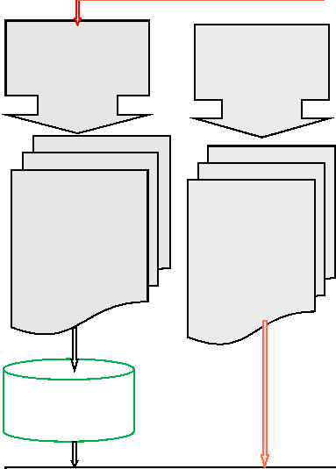
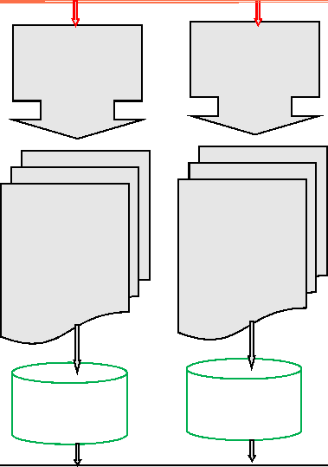
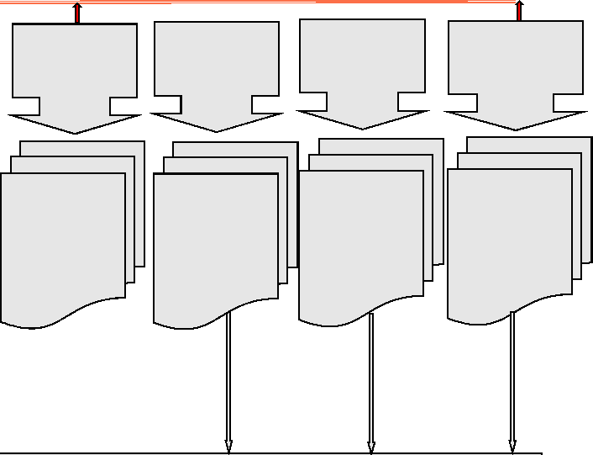
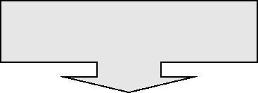
Prudent Valuation: EBA RTS High Level Overview
Mid Market Uncertainty for Levels 1-2 & Level 3
Concentration Uncertainty
Bid Offer Uncertainty
Model risk
Funding Assumption
Credit
Valuation
Adjustment
Uncertainty
Early
termination
Op Risk
Admin Cost
Level 3: Based on Existing Disclosures
Level 1&2: Based on main risk factors
Case-specific
analysis for
concentrated
positions
Analysis of
potential
alternative
assumptions
Analysis of
potential
alternative
assumptions
Simulation
Simulation
statistical
analysis
+5%
50% Netting
across asset
classes
50% Netting
across asset
classes
50% Netting
across asset
classes
Prudent Valuation Charge
14

Slide 15
The multi dimensional aspect of valuation(s)
Books&Records “Fair Value”
Mid mark estimate
Prudent Value
Solvent wind down Value”
Fire Sale Value”
uncertainty range,
level 3 disclosures
stdev
Plausible range of values of an asset
15
14

Slide 16
Valuation in solvent wind down : A genuine exit value, given a wind-up scenario
The PRA expects firms to consider the following drivers when assessing portfolio exits
Loss of Market Maker exemption move from mid-market to bid-offer (firms can no longer make use of client flow to exit at mid or better)
Residual un-hedgeable risks (typically expressed as a premium on the required rate of return)
Discount required to account for risk neutralisation or sale, over existing fair value reserves due to concentration (depth of the market) as accounting standards require valuations based upon price for a single normal market size transaction
The cost to tear-up and replace inter-affiliate hedges
Discount required to cover the future operational cost of the buyer (to manage the portfolio)
Discount required to price an appropriate return on capital (KVA into derivative trades required return on capital (where the likely buyer regulated entity typically a broker dealer)
Offsets can be considered, such as franchise value, market shares, RWA reductions to buyers due to matching exposures
16
13

Slide 17
Valuation in Stress Testing: following accounting approach, but under stressed market contitions
Updated PRA Framework (2024 update):
First, the Bank expects to carry out a Bank Capital Stress Test every other year. This will be a test of risks related to the financial cycle in which the largest and most systemic UK banks participate, and will be used to inform the setting of capital buffers for the banking system and individual banks. (...)
The scenario used in this test will be severe but plausible, vary with the state of the financial cycle and typically be countercyclical. The results of the test will be informed by the Bank of England’s and participating banks’ estimates of the impact of the stress scenario. The Bank expects to publish the results at an aggregate and bank-specific level and to use them to inform the setting of capital buffers for the banking system and individual participating banks, as well as to inform broader understanding of risks.
https://www.bankofengland.co.uk/stress-testing/2024/boes-approach-to-stress-testing-the-uk-banking-system
Re-computing regulatory capital under stressed contitions
Full revaluation of bank’s positions under stressed contitions
Projection of P&L over the projection horizon (typically 1 - 5 years)
Impacting Regulatory Capital Pillar 2B
17
13

Slide 18
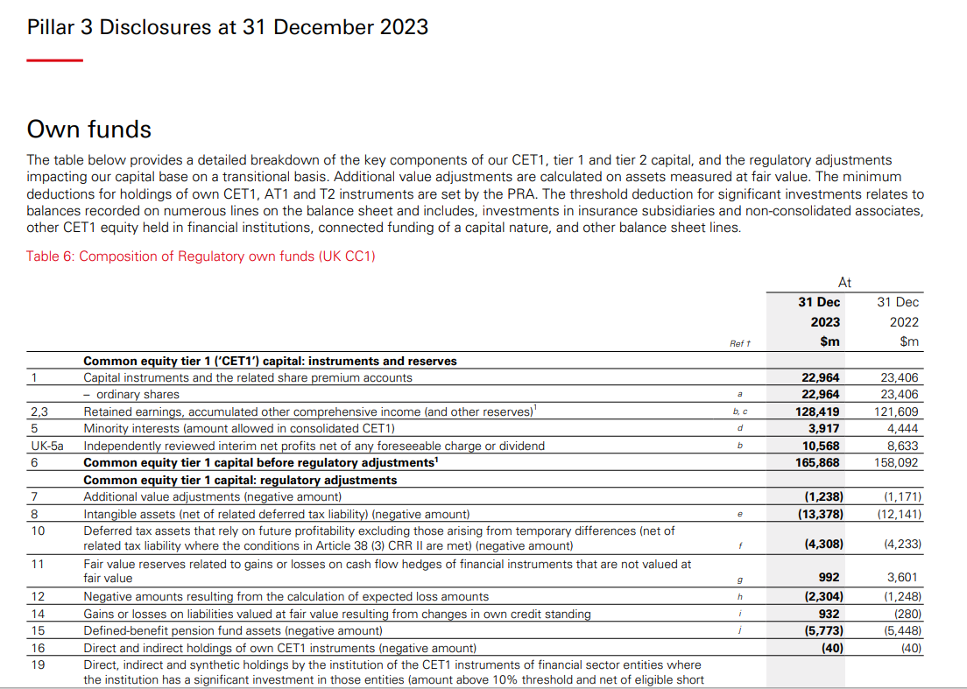
15
18

Slide 19
PVA : Key figures
Group PVA amounts to $1,238m as at end of 23Q4
Key ratios (EY 2020 survey)
      ~ 1% CET1 (vs 0,5%-2% Industry range)
      ~ 1,4% CCR & MR RWAs (vs 1,25% average Industry standard)
      ~ 100% FVAs (vs 170% Industry average )
      ~ 7% L3 assets ( vs 5%-10% Industry range)
      ~ 0,1% FV assets&liabilities
Group PVA quarterly variability: $+/-80m (MSS +/- $50m)
DB: $2,000m
BNPP: $1,600m
Barclays: $1,500m
SG: $0,850m
16

Slide 20
FVA / PVA : Key notions
Fair Value Adjustments
IPV
Bid –Offer
CVA
DVA
FFVA
Market data uncertainty
Model Limitation
Model Uncertainty
Early termination
Future Income Adjustment
Day One P&L reserve
Fair Value
    Best estimate of the exit price
Principal / Most advantageous market
Orderly transaction
Blockage discounts are prohibited
Own probability of default accounted for
Prudent Value
Going concern
  Orderly transaction
    conservative estimate of economic value, capturing (i) unexpected uncertainty, (ii) P&L slippage and (iii) hidden costs
    90% confidence level
“Fair Value at Risk” at a point in time
AVA= FVA-PVA deducted from CET1
  Solvent wind down exit value
  Business forced sale
17

Slide 21
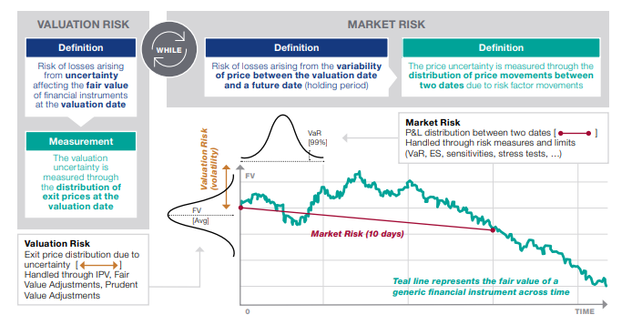
FVA / PVA : Key notions
18

Slide 22
Prudent Valuation: Current Scope
As at end of December 2013, scope was extended to all Firms’ positions that are fair valued and within the scope of regulatory consolidation, including FVOCI exposures.
Only legal entities that are specifically PRA / ECB / HKMA regulated are impacted at the legal entity level.
PVA is not implemented in the US but PVA for exposures booked in the US is accounted for at parent company level.
22

Slide 23
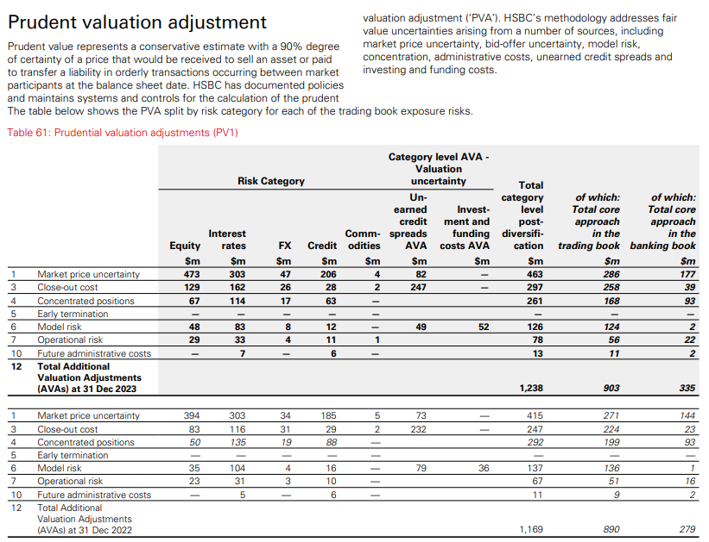
Pillar 3 Disclosure – PVA standing text and table review at 31 December 2023
*
20

Slide 24
Prudent Valuation: Mid Price Uncertainty (MPU) AVA
1.28 σ ----> 90% 1 tail CI
potential overlap with bid offer calculation is not recognized by PRA/ECB
“Bid offer spread are not a proxy of market price dispersion” (PRA)
All relevant sources must be considered (Consensus, Broker quotes, Collateral, executed prices…)
Where a portfolio approach is adopted, risk bucketing granularity must be challenged and must achieve a 90% P&L explanatory power
For some products, uncertainty measurement is netted across a set of consistent and interrelated risk factors (E.g. a “curve”) instead of being computed in isolation for each risk point and simply added.
Highly liquid products may be assigned a zero price uncertainty subject to proper documentation.
24

Slide 25
Prudent Valuation : Mid Price Uncertainty AVA
Data relevance and dispersion bias
Mid market?
Expected exit price?
Prudent exit price?
Capital Charge,
22

Slide 26
Prudent Valuation : Mid Price Uncertainty AVA
Data relevance and dispersion bias
23

Slide 27
Prudent Valuation : Mid Price Uncertainty AVA
EBA RTS Article 8&9, P&L Variance test
The granularity at which AVAs on valuation exposures shall be assessed shall be determined as follows:
(a) Institutions shall calculate AVAs on valuation exposures related to each valuation input used in the relevant valuation model. For non-derivative valuation positions, or valuation positions for which there is a directly observable price, the valuation input shall be the price of the instrument.
(b) In the case where a valuation input consists of a matrix of parameters, AVAs shall be calculated based on the valuation exposures related to each parameter within that matrix. Where a valuation input does not refer to tradable instruments, institutions shall map the valuation input and the related valuation exposure to a set of market tradable instruments.
Institutions may reduce the number of parameters of the valuation input for the purpose of calculating AVAs provided:
The total value of the reduced valuation exposure is the same as the total value of the original valuation exposure.
The reduced set of parameters can be mapped to a set of market tradable instruments.
The ratio of [P&L] volatility variance measure 2 over [P&L] volatility variance measure 1 as defined below, based on historical data from the most recent 100 trading days, is less than 0.1:
Volatility measure 1: Profit and Loss volatility of the valuation exposure based on the unreduced valuation input.
Volatility measure 2: Profit and Loss volatility of the valuation exposure based on the unreduced valuation input minus the valuation exposure based on the reduced valuation input.
(c) Where a reduced number of parameters are used for the purpose of calculating AVAs, the determination that the above criteria are met shall be subject to independent review of the netting methodology and validation on at least an annual basis.
24

Slide 28
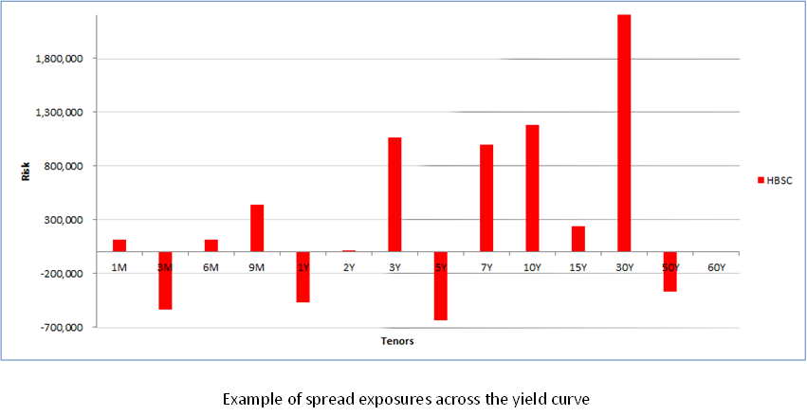
Prudent Valuation : Mid Price Uncertainty AVA
25

Slide 29
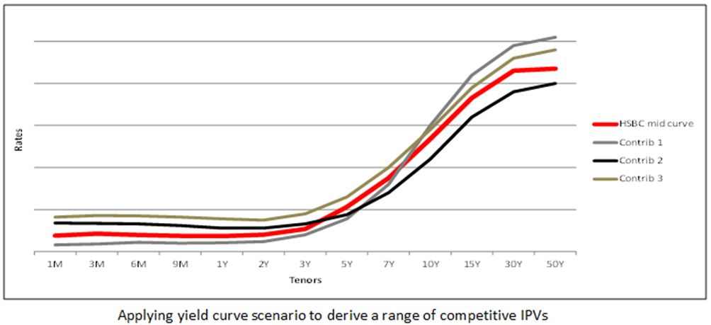
Prudent Valuation : Mid Price Uncertainty AVA
26

Slide 30
Prudent Valuation / Concentration AVA
EBA RTS Article 14, Calculation of Concentrated Positions AVA
1. Institutions shall estimate a concentrated position AVA for concentrated valuation positions (‘individual concentrated positions AVA’) by applying the following three-step approach:
(a) Firstly, they shall identify concentrated valuation positions;
(b) Secondly, for each identified concentrated valuation position, where a market price applicable for the size of the valuation position is unavailable, they shall estimate a prudent exit period;
(c) Only where the prudent exit period exceeds 10 days, they shall estimate an AVA taking into account the volatility of the valuation input, the volatility of the bid offer spread and the impact of the hypothetical exit strategy on market prices.
2. For the purposes of point (a) of paragraph 1, the identification of concentrated valuation positions shall consider all of the following:
(a) the size of all valuation positions relative to the liquidity of the related market;
(b) the institution’s ability to trade in that market;
(d) the average daily market volume and typical daily trading volume of the institution.
27

Slide 31
Prudent Valuation / Concentration AVA
Theoratical calculation subject to numerous assumptions
Establishing the risk hedging strategy
Gauging / extrapolating market volumes
Assessing the fraction of markets volume that one Firm can trade without impacting market price
Understanding the overlap with the 10 days market risk RWA calculation
Modelling the underlying price slippage (diffusion process)
28

Slide 32
Prudent Valuation / Concentration AVA
Assumptions
• Desk pvbp (cs01): 200k $/bp
• Daily tradable pvbp: 20k $/bp
• Fraction of daily volume that can be traded without shifting market price: 20%
• Yield (spread) daily volatility: 5 bp / day (equivalent to 1 standard deviation / daily expected market
move)
Calculations:
Liquidity horizon: 200 k / ( 20% x 20k) = 50 days
Extra period of time: 50 - 10 = 40 days
The 90% AVA for concentration estimates the potential realized MtM slippage over the close out period:
29

Slide 33
Prudent Valuation / Concentration AVA
Alternative computations
Very crude calculation (Exposure is assumed to be closed out on T+50 without amortization). Underlying
risk factors follows a diffusion process in square root of time : 200k * 5bp * 1.28 * √ 50
Crude calculation (Exposure is assumed to be closed out on T+50 without amortization but only the extra
unwind period of time -40 days- is accounted for). Underlying risk factors follows a diffusion process in square root of time : (200-10*4) k * 5bp * 1.28 * √ 40
Less crude calculation (assuming an average extra carrying period of 20 days) : (200-10*4) k * 5bp * 1.28 * √ 20
Approximate and conservative calculation: exposure is stripped into individual components according to their daily liquidity horizon and an independent unwind cost is compute d for each unwind. (risk factor diffusion is clearly not mean reverting) : (20% x 20k)* 5bp * 1.28 * (1+ √2+√3+…√40)
Integrating the above formula gives: (20% x 20k)* 5bp *([40]³/3)^{0,5} *1.28
Exact calculation: Run a Monte Carlo simulation that mimics the diffusion of the underlying risk factor and for each set of scenario, compute the realized daily P&L when selling down the portfolio. Then derive 90% quantile.
30

Slide 34
Prudent Valuation / Concentration AVA
Alternatively, modelling the market price impact (i.e. size adjusted price)
linearly with trade size
at a decreasing rate
instantaneous vs permanent impact
“market price impact” : 1.28 σ x ( Q / V)^{α}
See
  https://www.riskdata.com/wp-content/uploads/Liquidity-risk_Riskdata-white-paper_2015.pdf
  https://arxiv.org/pdf/0903.2428.pdf
31

Slide 35
Prudent Valuation / Concentration AVA
“Bloomberg Delivers First Quantitative Model For Calculating Liquidity Risk” March 2016”
“Bloomberg’s Liquidity Assessment Tool (LQA) pioneers the use of machine learning to estimate liquidity risk as global regulators oblige institutional investors to factor liquidity into risk and pricing models”
“Bloomberg LQA provides risk managers, portfolio managers, traders, and compliance officers with a standard definition of liquidity and a consistent approach to measuring the expected cost of liquidation for a specific volume of securities, and a desired time horizon. It also provides a score designed to indicate security-level liquidity with respect to liquidation cost and its distributions across different volumes”
“Bloomberg assembled a multidisciplinary team of experts to consider all of the complexities associated with liquidity risk analysis. Bloomberg LQA uses machine learning techniques, such as cluster analysis, to dynamically identify and leverage transaction data for comparable securities.”
32

Slide 36
Prudent Valuation / Concentration AVA
“Markit Pricing Data delivers an independent set of liquidity measures, including an easily understood and transparent liquidity score”
“The ability to exit a position with minimal price impact is important to many market participants. Markit Pricing Data provides insight into the flow of information in the CDS market to help assess liquidity.”
Our liquidity data is delivered with our fixed income pricing data and offers insight into the depth and breadth of the market. It helps enhance transparency across fixed income markets and supports changing regulatory and valuation requirements
The data supports risk management, including exit cost analysis and valuation uncertainty, as well as independent price verification, margin calculations, management information reports and portfolio management. It may also serve as an input to regulatory reporting under requirements such as IFRS 13, FASB’s ASC Topic 820 (FAS 157), UCITS and EBA’s prudent valuation standards.
Markit Pricing Data produces and derives liquidity metrics using a transparent methodology to enable customers to assess liquidity in the CDS market.”
33

Slide 37
Prudent Valuation / Concentration AVA
“Interactive Data’s Liquidity Indicators provide an independent view of near-term relative liquidity – informing your decisions with a better understanding of security and portfolio liquidity. Our uniform liquidity scale facilitates the comparison of securities across asset classes.”
“Liquidity Indicators are powered by Interactive Data’s award-winning fixed income evaluation and reference data* and sophisticated, proprietary modelling techniques. »
Our Liquidity Indicators provide a transparent methodology and set of metrics to measure liquidity defined as “the ability to exit a position at or near the current value”.
Metrics include:
Projected Trade Volume Capacity
Projected Future Price Volatility
Liquidity Ratio per Security
Liquidity Score (1-10) based on a rank ordering of securities
Comparative Score (vs. universe, asset class, sector, etc.)
Projected Days to Liquidate
Projected Market Price Impact
Liquidity Gauges to view trends over time
34

Slide 38
Prudent Valuation: Close out Cost (CoC) AVA
bid offer spread uncertainty : ~50 %
risk bucketing granularity adopted for prudent valuation must achieve a 90% P&L explanatory power
netting rules: portfolio vs desk vs room
prudent correlation matrix must be considered
38

Slide 39
Prudent Valuation / Model Risk AVAs
EBA RTS Article 11 Calculation of Model risk AVA
1. Institutions shall estimate a model risk AVA for each valuation model (‘individual model risk AVA’) by considering valuation model risk which arises due to the potential existence of a range of different models or model calibrations, which are used by market participants, and the lack of a firm exit price for the specific product being valued. Institutions shall not consider valuation model risk which arises due to calibrations from market derived parameters, which shall be captured according to Article 9.
2. The model risk AVA shall be calculated using one of the approaches defined in paragraphs 3 and 4.
3. Where possible, institutions shall calculate the model risk AVA by determining a range of plausible valuations produced from alternative appropriate modelling and calibration approaches. In this case, institutions shall estimate a point within the resulting range of valuations where they are 90% confident they could exit the valuation exposure at that price or better.
4. Where institutions are unable to use the approach defined in paragraph 3, they shall apply an expert-based approach to estimate the model risk AVA. The expert-based approach shall consider all of the following: complexity of products relevant to the model; diversity of possible mathematical approaches and model parameters, where those model parameters are not related to market variables; the degree to which the market for relevant products is ‘one way’; the existence of unhedgeable risks in relevant products; and the adequacy of the model in capturing the behaviour of the pay-off of the products in the portfolio. Institutions shall notify competent authorities of the models for which this approach is applied, and the methodology used to determine the AVA.
5. Where institutions use the method described in paragraph 4, the prudence of the method shall be confirmed annually by comparing the following:
(a) the AVAs calculated using the method described in paragraph 4, if it were applied to a material sample of the valuation models for which the institution applies the method in paragraph 3; and
(b) the AVAs produced by the method in paragraph 3 for the same sample of valuation models.
36

Slide 40
Prudent Valuation / Model Risk AVAs
Differentiating between Books&Records and Capital Adjustments
“Known Knowns” --------> Model Limitation Fair Value Adjustments
“Known Unknowns” / expected uncertainty --------> Model Uncertainty Fair Value Adjustments
“Unknown Unknowns” / Unexpected uncertainty --------> Model Uncertainty Additional Valuation Adjustments
37

Slide 41
Prudent Valuation / Model Risk AVAs
Characteristics
Second order risk
Remote but still plausible risk
Preemptive and cautionary step
Forward looking
New model still being in a testing phase
Temporary or exploratory solution when Industry practices are still evolving
38

Slide 42
Prudent Valuation / Model Risk AVAs
Usual Suspects
Extrapolation / interpolation rules
Discounting curve assumptions
Static parameter that could exhibit a term structure
Static parameters term structure that could exhibit a “skew” structure
Static parameters that could exhibit a specific dynamic, hence the need to introduce stochasticity and potentially correlation with other dynamic risk factors
Convexity effects
Non-Gaussian dependences /Dynamics
39

Slide 43
Prudent Valuation / Model Risk AVAs
Usual Suspects (continued)
Numerical resolution
Discontinuities
Basis
Cost of re hegding
Grouping /mapping/bucketing assumptions
Legal subtleties (“out of the money clauses”)
40

Slide 44
Prudent Valuation / Model Risk AVAs
Detections
Independent Model review
Recurrent consensus rejections
Material IPV compared to Fair value adjustments
Collateral disputes
Unanticipated /unexplained inception or close out P&L
Daily P&L persistent slippage
High / Low Hit ratios observed in competitive auctions
Market Intelligence
41

Slide 45
Prudent Valuation / Model Risk AVAs
Resolutions
Shifting exotic parameters
Removing long optionality
Alternative pricing on a representative sample of trades / on the entire portfolio
Extrapolating prices dispersion derived from exotic contributions to consensus
Enhanced numerical resolution
No Model risk AVA consensus available yet
Level of desired accuracy to be commensurate with the 90% confidence target
Boundary conditions may be considered, however PVA should not be a worst case
42

Slide 46
Prudent Valuation / Model Risk AVAs
Possible overlap with or collateral effect on other calculations
Bid Offer , as greeks are impacted
Parameters uncertainty, as sensitivities may be removed
Market risk RWA, as risk profile may be reduced
Modellability ? (FRTB)
Frontier with accounting rules?
43

Slide 47
Prudent Valuation/ Model Risk AVA
Captures remote / tail model risk
Applicable to cutting edge pricing / emerging modelling
Cautionary step before implementing FVAs
Reflects and addresses 2LOD recommendations and Subjectives
Regulation require multiple alternative models to be tested
An appropriate quantitative measure of model risk, amenable to risk appetite
47

Slide 48
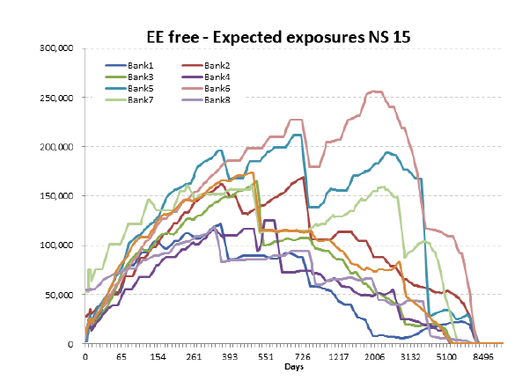
Prudent Valuation / Model Risk AVAs / CVA (Unearned Credit Spread)
https://www.eba.europa.eu/documents/10180/950548/EBA+report+on+CCR+benchmarking+2014
45

Slide 49
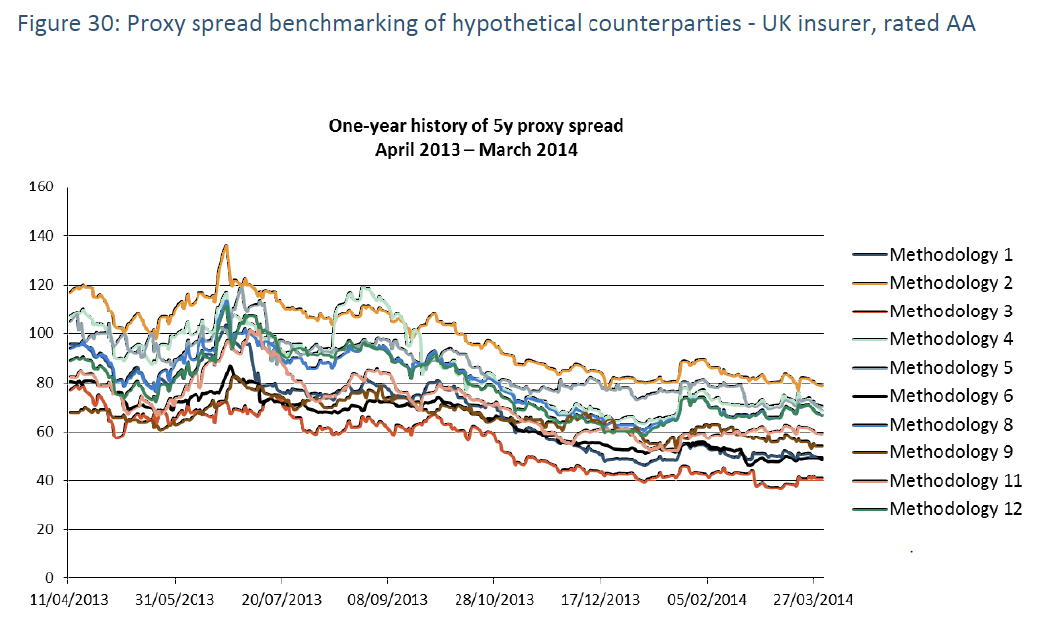
Prudent Valuation / Model Risk AVAs / CVA (Unearned Credit Spread)
https://www.eba.europa.eu/documents/10180/950548/EBA+Report+on+CVA.pdf
46

Slide 50
Prudent Valuation / Admin Cost AVA
Article 15 Calculation of Future administrative costs AVA
1. Where an institution calculates market price uncertainty and close-out cost AVAs for a valuation exposure, which imply fully exiting the exposure, the institution may assess a zero AVA for future administrative costs.
2. Where a valuation exposure cannot be shown to have a zero AVA according to paragraph 1, institutions shall calculate the future administrative cost AVA (‘individual future administrative costs AVA’) considering the administrative costs and future hedging costs over the expected life of the valuation exposures for which a direct exit price is not applied for the close-out costs AVA, discounted using a rate which approximates the risk free rate.
3. For the purposes of paragraph 2, administrative costs shall include all incremental staffing and fixed costs that will be incurred in managing the portfolio but a reduction in these costs may be assumed as the size of the portfolio reduces.
47

Slide 51
Prudent Valuation: regulatory key expectations
Calculation completeness must be evidenced
Effective Linkage with Model review findings must be established
Data quality and significance must be assessed as uncertainty measurement being highly dependent on sampled observations
Extrapolation and approximations must be disclosed and should attract an additional layer of prudence
Governance: right MI to be escalated to Senior Management
Documentation must be enriched, with specific attention to arbitrary assumptions
Back testing with Daily 1 P&L review is required
51

Slide 52
Prudent Valuation
EBA RTS footnote:
“ The EBA accepts that for the majority of positions where there is valuation uncertainty, it is not possible to statistically achieve a specified level of certainty; however, specifying a target level is believed to be the most appropriate way to achieve greater consistency in the interpretation of a ‘prudent’ value.”
49

Slide 53
Prudent Valuation
Q&A
50

